Slide 1
Teaching Phonological Awareness Using the Heggerty Curriculum

Slide 2
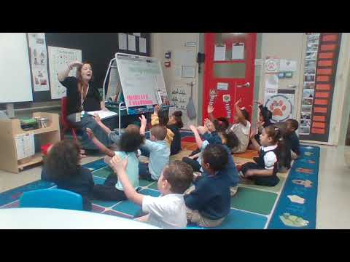
Heggerty in Action
Pre-Kindergarten – Week 16
https://www.youtube.com/watch?v=ymdzJN0Us4c&list=PLCkBP2csbOsu001Npq5wJKQ7WzWMj1EsL&index=11
Notes:
This is a PreK video from PaTTAN (Pennsylvania Training and Technical Assistance Network). The channel can be found using this link: https://www.youtube.com/playlist?list=PLCkBP2csbOsu001Npq5wJKQ7WzWMj1EsL
Use the video which is applicable to your participants, i.e., if you are working with a group of preschool teachers then there is no need to show them the video of the primary curriculum being implemented.
As participants watch the video, ask them to watch what the teacher is doing as well as the students. After the video, ask them to discuss what they noticed. What are the take-aways from this?
https://www.youtube.com/watch?v=ymdzJN0Us4c&list=PLCkBP2csbOsu001Npq5wJKQ7WzWMj1EsL&index=11

Slide 3
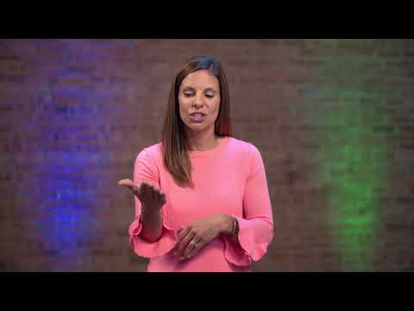
Blending
https://www.youtube.com/watch?v=AblTo7bS0MI
Notes:
This video is from the Heggerty YouTube channel https://www.youtube.com/channel/UC7md7J-Hl65IjZZCg-wN4YA
Video: https://www.youtube.com/watch?v=AblTo7bS0MI

Slide 4
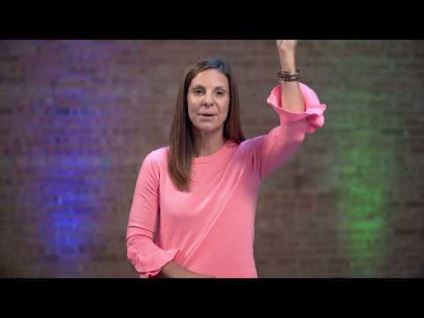
Final Sounds
https://www.youtube.com/watch?v=1h9sQSx1pvQ
Notes:
This video is from the Heggerty YouTube channel https://www.youtube.com/channel/UC7md7J-Hl65IjZZCg-wN4YA
Video: https://www.youtube.com/watch?v=1h9sQSx1pvQ

Slide 5
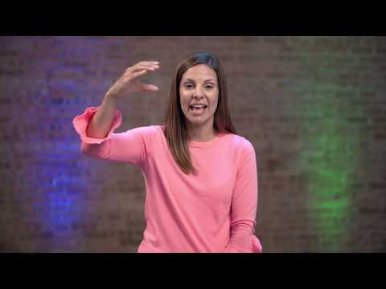
Medial Sounds
https://www.youtube.com/watch?v=Hx_xaPHAMXY
Notes:
This video is from the Heggerty YouTube channel https://www.youtube.com/channel/UC7md7J-Hl65IjZZCg-wN4YA
Video: https://www.youtube.com/watch?v=Hx_xaPHAMXY

Slide 6
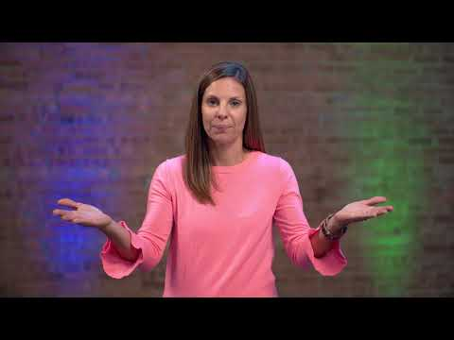
Segmenting
https://www.youtube.com/watch?v=FgcXDKLLMSI
Notes:
Video: https://www.youtube.com/watch?v=FgcXDKLLMSI

Slide 7
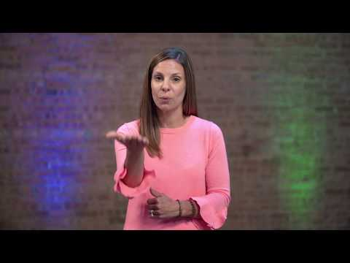
Adding Phonemes
https://www.youtube.com/watch?v=cGr3ZcRflPQ
Notes:
This video is from the Heggerty YouTube channel https://www.youtube.com/channel/UC7md7J-Hl65IjZZCg-wN4YA
Video: https://www.youtube.com/watch?v=cGr3ZcRflPQ

Slide 8
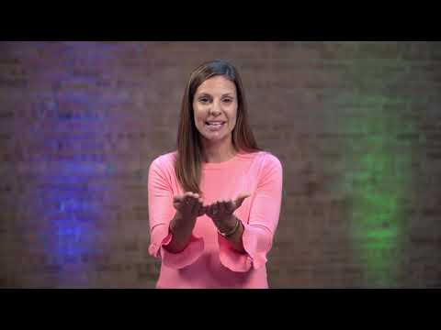
Deleting Phonemes
https://www.youtube.com/watch?v=pQ9cS9AJ4Oc
Notes:
Video: https://www.youtube.com/watch?v=pQ9cS9AJ4Oc

Slide 9
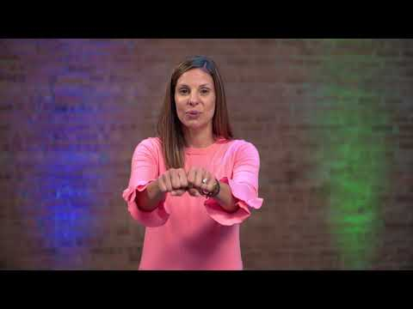
Substituting Phonemes
https://www.youtube.com/watch?v=AFiLleT1Zro
Notes:
This video is from the Heggerty YouTube channel https://www.youtube.com/channel/UC7md7J-Hl65IjZZCg-wN4YA
Video: https://www.youtube.com/watch?v=AFiLleT1Zro

Slide 10
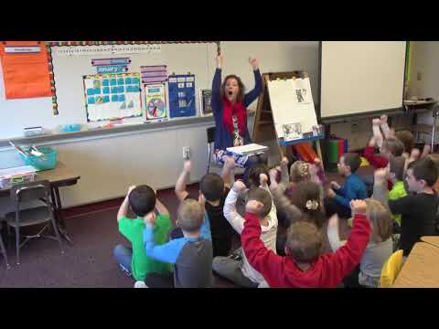
Putting It All Together
Kindergarten – Week 17
https://www.youtube.com/watch?v=JXpOaPzJEHc&list=PLCkBP2csbOsu001Npq5wJKQ7WzWMj1EsL&index=10
Notes:
As participants watch the video, ask them to watch what the teacher is doing as well as the students. After the video, ask them to discuss what they noticed. What are the take-aways from this?
https://www.youtube.com/watch?v=JXpOaPzJEHc&list=PLCkBP2csbOsu001Npq5wJKQ7WzWMj1EsL&index=10 https://www.youtube.com/watch?v=JXpOaPzJEHc&list=PLCkBP2csbOsu001Npq5wJKQ7WzWMj1EsL&index=10

Slide 11
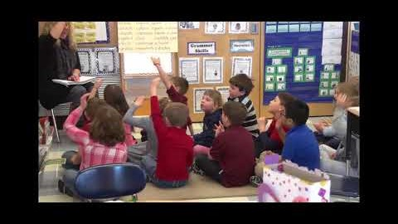
Putting It All Together
Primary – Week 15
Notes:
This is a PreK video from PaTTAN (Pennsylvania Training and Technical Assistance Network). The channel can be found using this link: https://www.youtube.com/playlist?list=PLCkBP2csbOsu001Npq5wJKQ7WzWMj1EsL
As participants watch the video, ask them to watch what the teacher is doing as well as the students. After the video, ask them to discuss what they noticed. What are the take-aways from this?
https://www.youtube.com/watch?v=YbmNTWPHG50&list=PLCkBP2csbOsu001Npq5wJKQ7WzWMj1EsL&index=2&t=0s

